Slide 1
Hotel Reservation SQL Analysis
Mentorness DATA ANALYST INTERN
Virginia Mamdouh

Slide 2
Overview
The hotel industry relies on data to make informed decisions and provide a better guest experience. In this internship, you will work with a hotel reservation dataset to gain insights into guest preferences, booking trends, and other key factors that impact the hotel's operations. You will use SQL to query and analyze the data, as well as answer specific questions about the dataset.

Slide 3
Dataset Overview:
The dataset includes the following columns:
Booking_ID: A unique identifier for each hotel reservation.
no_of_adults: The number of adults in the reservation.
no_of_children: The number of children in the reservation.
no_of_weekend_nights: The number of nights in the reservation that fall on weekends.
no_of_week_nights: The number of nights in the reservation that fall on weekdays.
type_of_meal_plan: The meal plan chosen by the guests.
room_type_reserved: The type of room reserved by the guests.
lead_time: The number of days between booking and arrival.
arrival_date: The date of arrival.
market_segment_type: The market segment to which the reservation belongs.
avg_price_per_room: The average price per room in the reservation.
booking_status: The status of the booking.

Slide 4
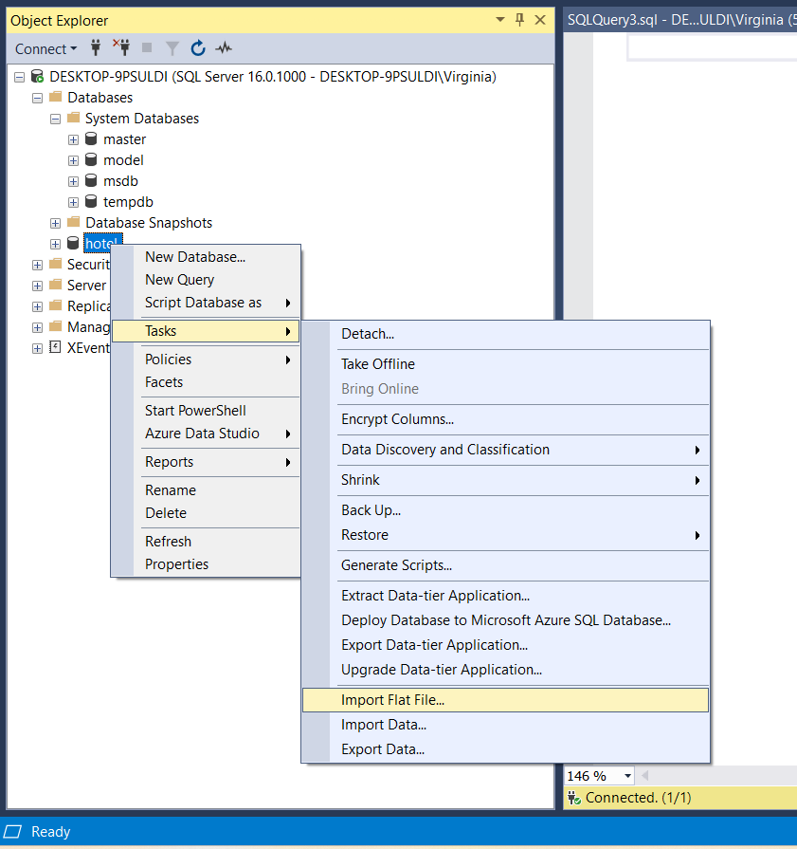
First thing to do is ..
- Converting the csv file into excel file and creating a table named Hotel Reservations Dataset. >> this will make importing and editing data into the sql server much easier for me. :)
- Then we’ll create a new database named ‘Hotel’ -click on it and we’ll import the table we created at the beginning into the database (import file, choose excel file, destination = sql server)

Slide 5
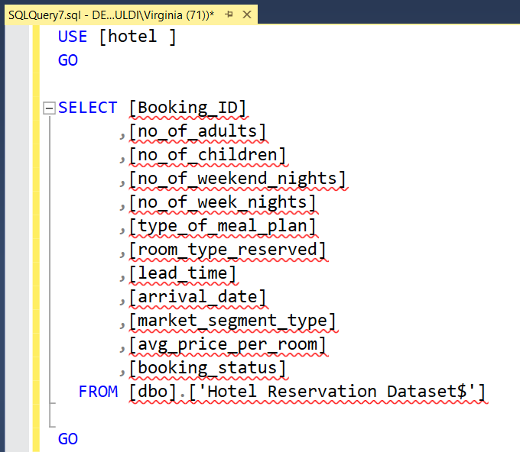
Second step is..
We’ll select the table to start working on it

Slide 6
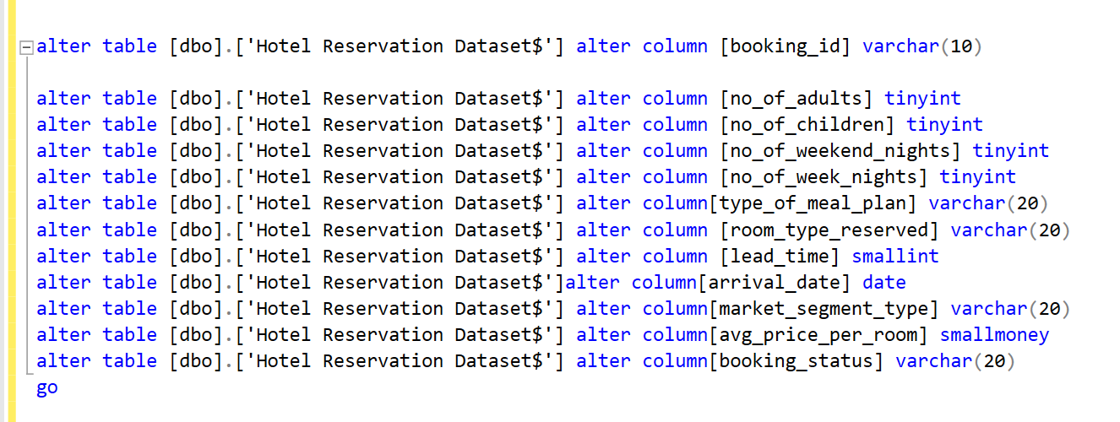
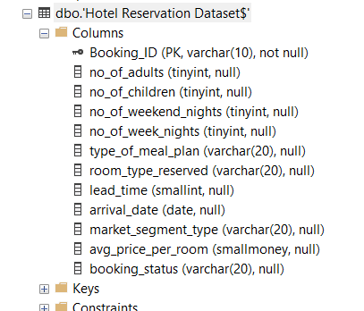
Then ..
Checking data types converting them to suitable types :)
Also making Bookong_ID column a primary key without any null values

Slide 7
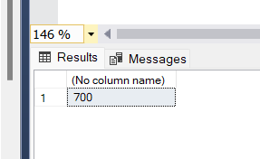
Now let’s start our task
First question is : What is the total number of reservations in the dataset?
That’s why we’ll count the booking IDs using the count function
Rsults >>
There are 700 reservations

Slide 8
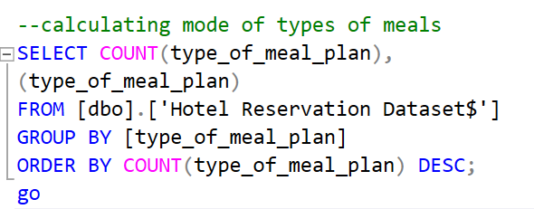
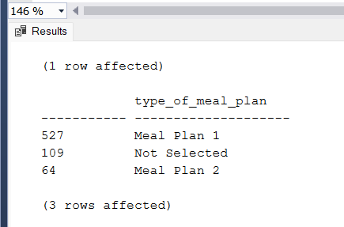
Second question is asking about the most popular meal among guests ..
Let’s calculate the mode of the types of meals
There is no mode in SQL, so we’ll use count and group by functions
As we can see the most popular meal is Meal plan 1

Slide 9
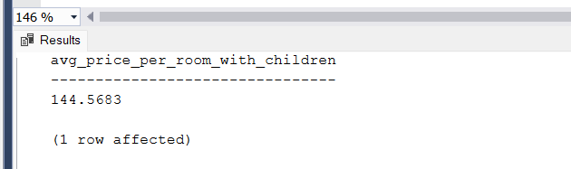
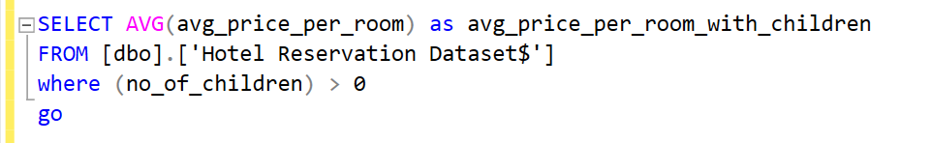
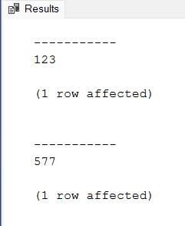
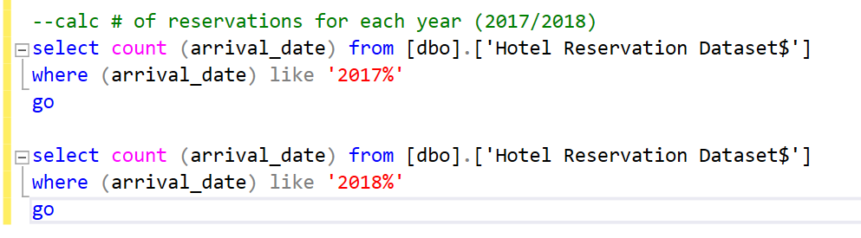
3rd Question is, what is the average price per room for reservations involving children?
Result is 144.57 :)
We’ll use the average with where function
4th Question is, How many reservations were made for the year 2017/2018?
There are 123 reservations In year 2017
and 577 reservations In 2018

Slide 10
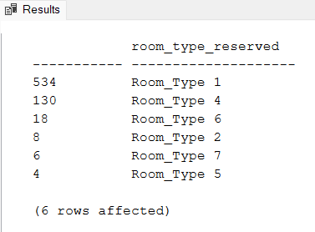
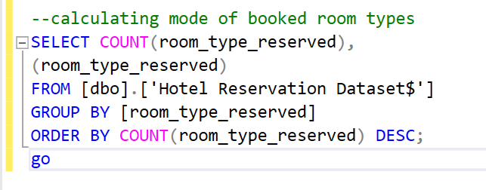
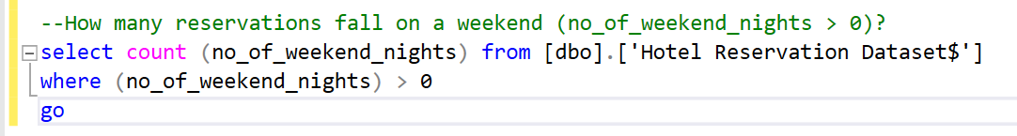
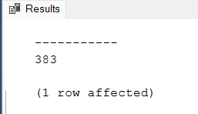
5th question is, what is the most commonly booked room type?
Most room type reserved is room_type_1
6th question is, How many reservations fall on a weekend?
There are 383 reservations fall on a weekend

Slide 11
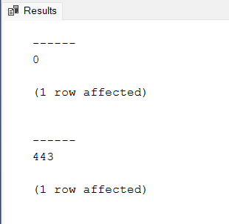
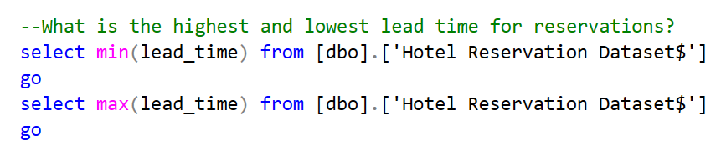
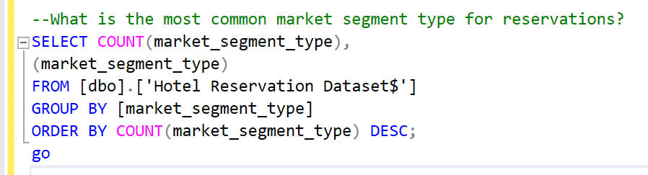
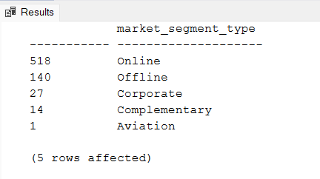
7th Question, what is the highest and lowest lead time for
reservations?
Min lead
time is 0 Max lead
Time is 433
8th Question, What is the most common market segment type for
reservations?
The most common market segment type is online with 518 records

Slide 12
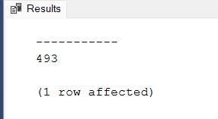
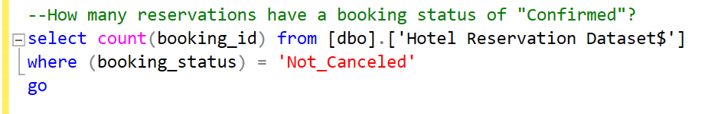
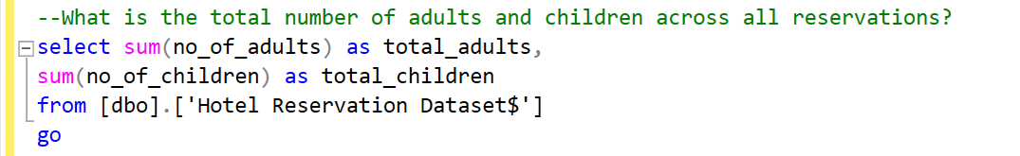
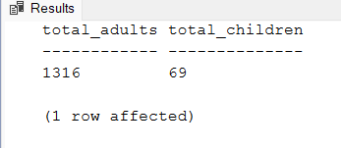
9th Question, how many reservations have a booking status
of "Confirmed"?
Confirmed reservtions are 493 record
10th Question, what is the total number of adults and children across all reservations?
Total adults are 1316 Total Children are 69 only

Slide 13
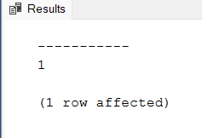
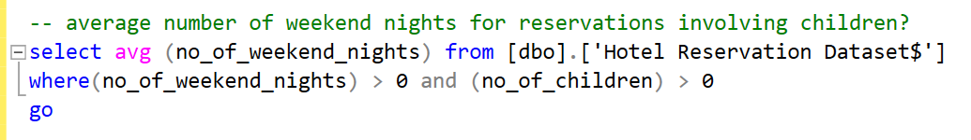
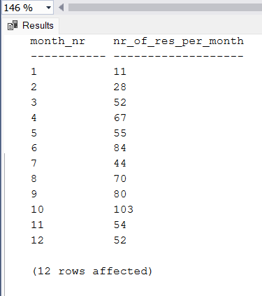
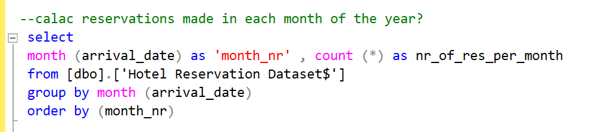
11th Question, what is the average number of weekend nights for reservations involving children?
Average nr of weekend nights with children's reservations is 1
12th Question, how many reservations were made in each month of the year?
Each month with its reservation records

Slide 14
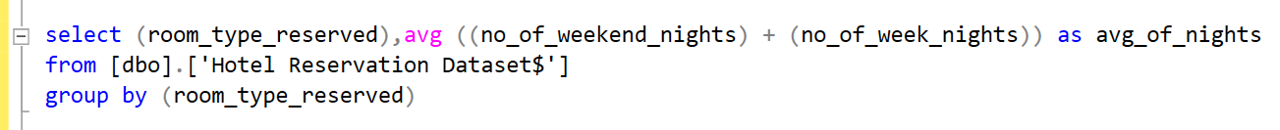
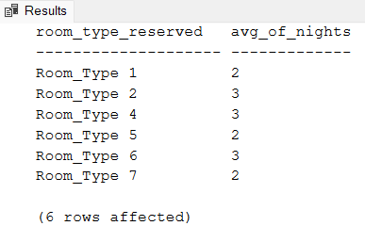
13th Question, What is the average number of nights (both weekend and weekday) spent by guests for each room type?
Each room type has its average reservations every night

Slide 15
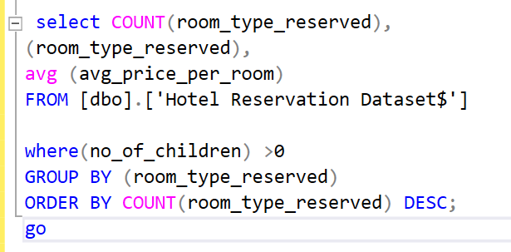
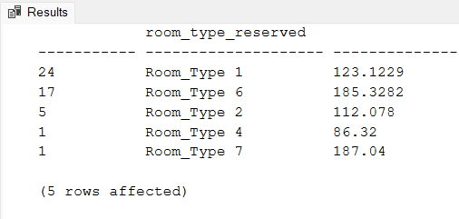
14th Question, For reservations involving children, what is the most common room type, and what is the average price for that room type?
Most common room type with children’s reservations
is room type 1 with average price of 123.123

Slide 16
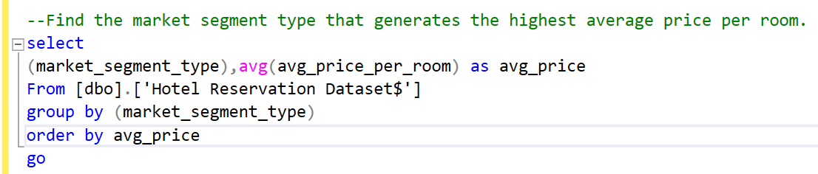
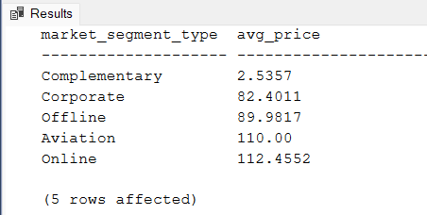
15th and last question..
Find the market segment type that generates the highest average price per room.
The market segment that generates the max average price per room is the Online segment

Slide 17

THAT WAS IT
THANK YOU FOR YOUR TIME

